Slide 1
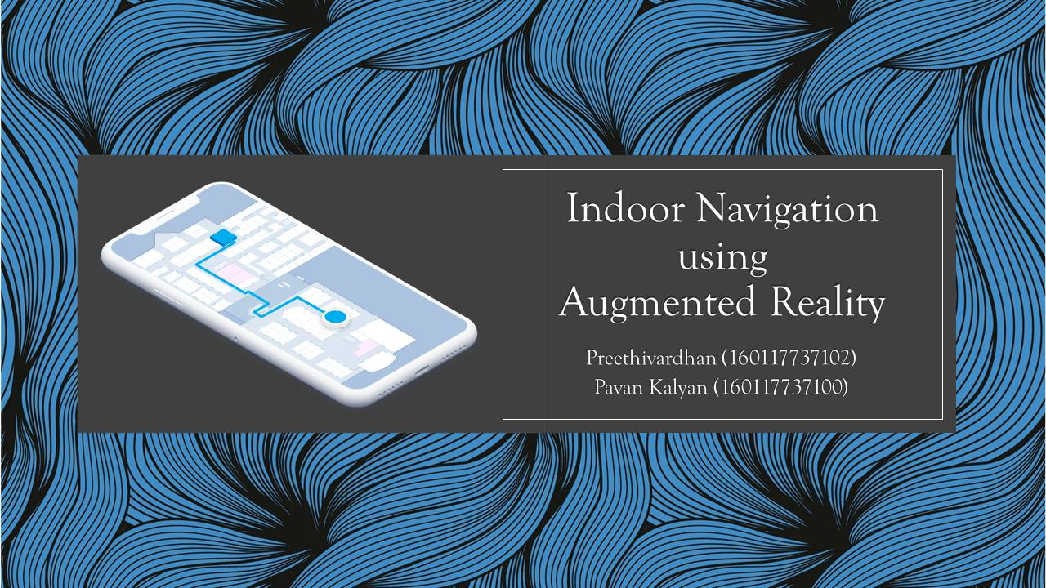

Slide 2
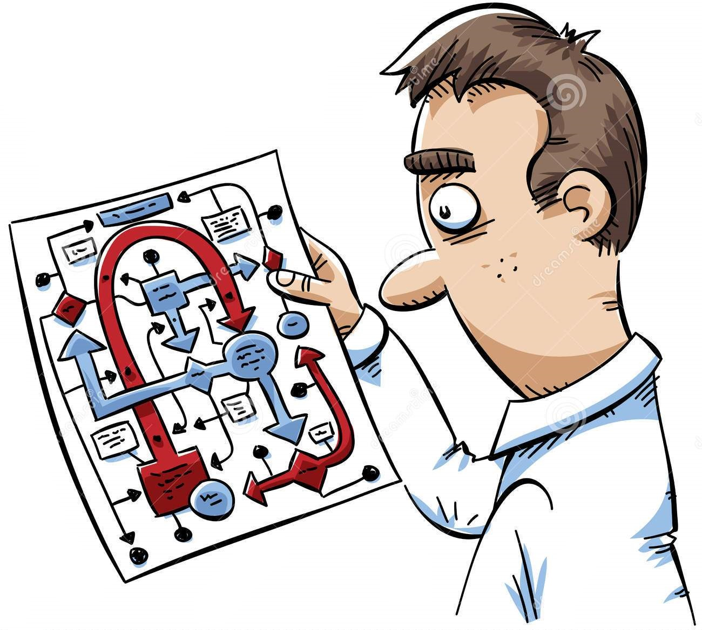
Introduction
With a Smartphone in hand, it is pretty easy for us to find our way to the destination using Google maps, even when we are in an unfamiliar city.
However, it is possible to get lost indoors like in Shopping Malls, Office buildings, etc.
Indoor navigation deals with navigation within buildings.

Slide 3
Problem Statement
Develop a mobile application which can navigate the user to any destination from any starting point within a given building.

Slide 4
Why Augmented Reality?
Since GPS reception is normally non-existent inside buildings, we cannot use Google Maps.
Wi-Fi or Bluetooth Beacons can be used for indoor navigation. But these have an accuracy of 5 – 15 meters which is inefficient and requires costly hardware installation.
It’s easier to navigate indoors when you can see the directions in your surroundings.
So, we intend to develop an AR application which will show the directions to the destination in the user’s camera. It is efficient and doesn’t require any hardware.

Slide 5
System Requirements
HARDWARE
Android phone with version 4 or above
512 MB or higher RAM
10 GB or higher memory
SOFTWARE
Unity with Android SDK
Google AR Core
Blender

Slide 6
Implementation
Unity is the development environment chosen for this project because of its ease of use.
The project consists out of four big parts, namely the QR-code positioning, the ARCore based localization, the Navigation (NavMesh), and lastly the AR view.
We need to install Android SDK and Google ARCore Plug-in for this project.

Slide 7
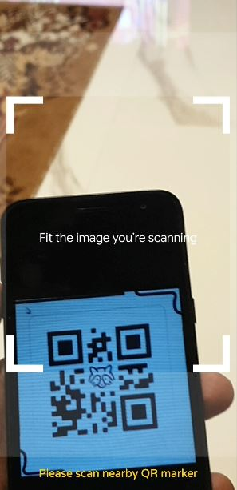
Positioning
For start position synchronization of the user, he needs to scan a QR code once he opens the app.
After that the users movement is tracked by the SLAM or Simultaneous Localization And Mapping algorithm which is provided by Google ARCore.
SLAM refers to the task of constructing an internal map of an unknown area whilst keeping track of its position inside the area.

Slide 8
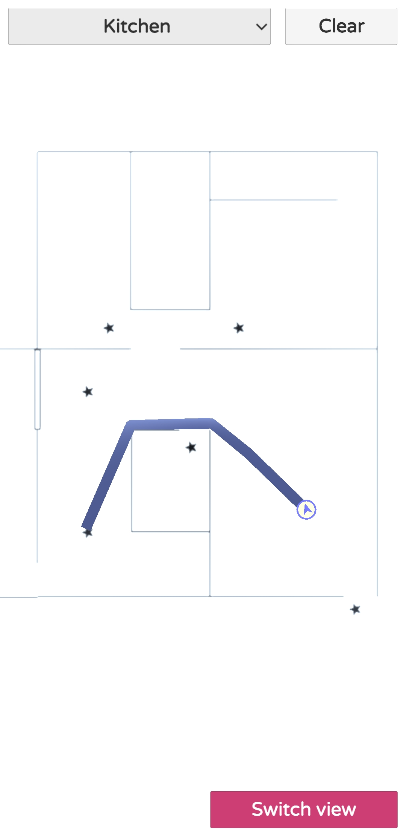
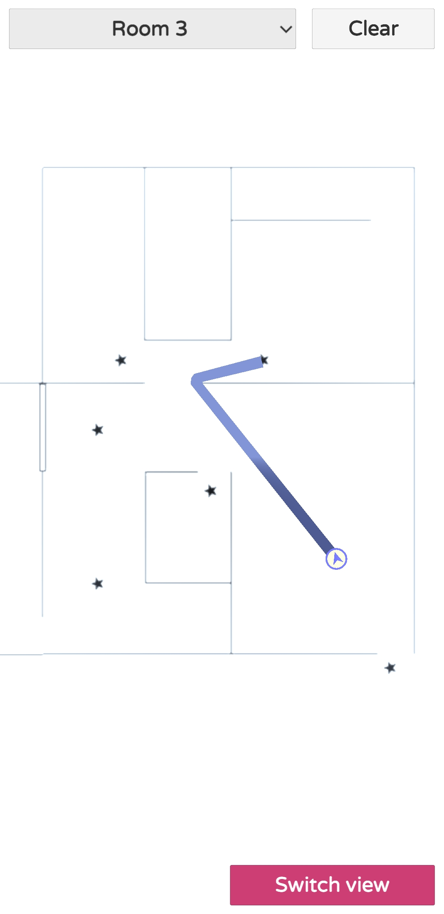
Navigation
Unity handles Optimal Path finding capabilities using Navmesh.
We need create a 3D model of the building where we are implementing this application.
After that we need to create all possible destinations.
We must add all the walls and obstacles to NavMesh components.
Once user chooses a destination, NavMesh automatically detects which surface is walkable and finds the shortest path to destination using A* Algorithm.

Slide 9
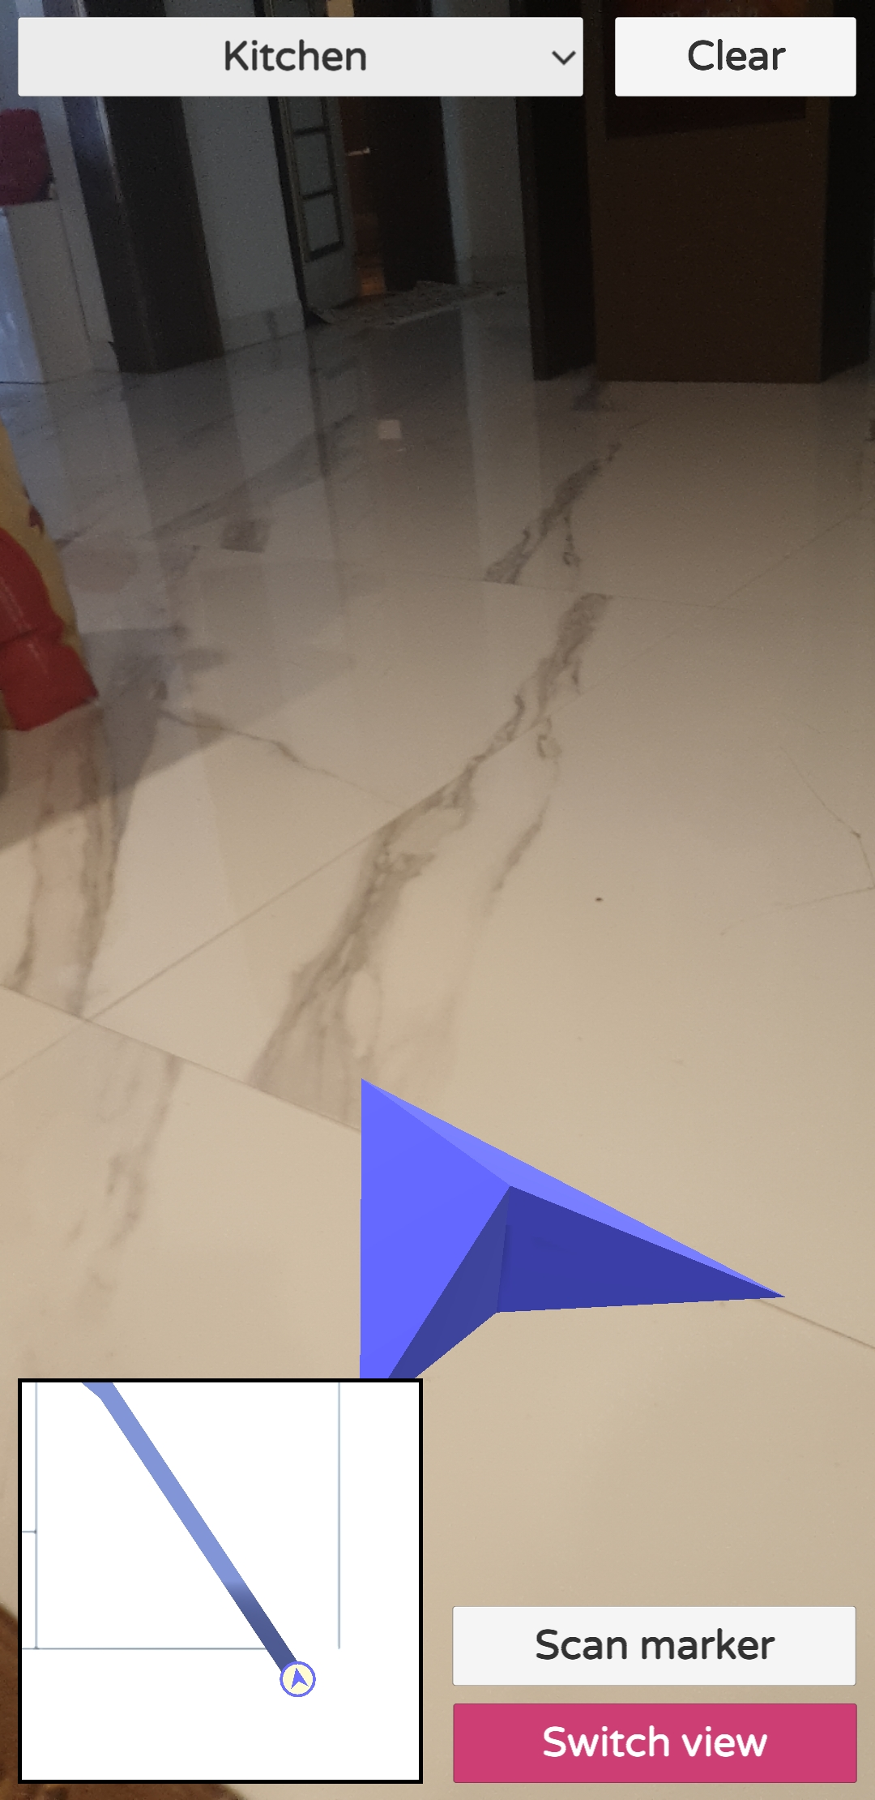
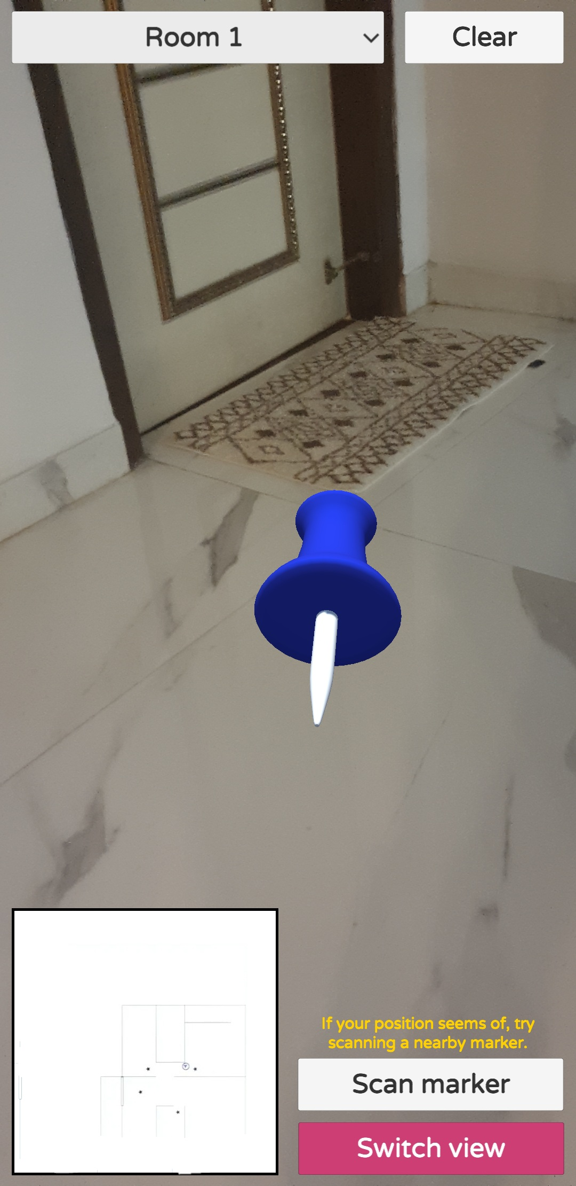
AR view
We shall create an arrow in AR which comes in front of the user that points in the direction the user needs to go.
C# scripts are written for the arrow in such a way that the arrow points towards the direction shown by the NavMesh Agent.
The arrow is designed in a way that, it moves along with the user when towards the destination.
Once the user approaches destination, a pin point is displayed in AR.

Slide 10
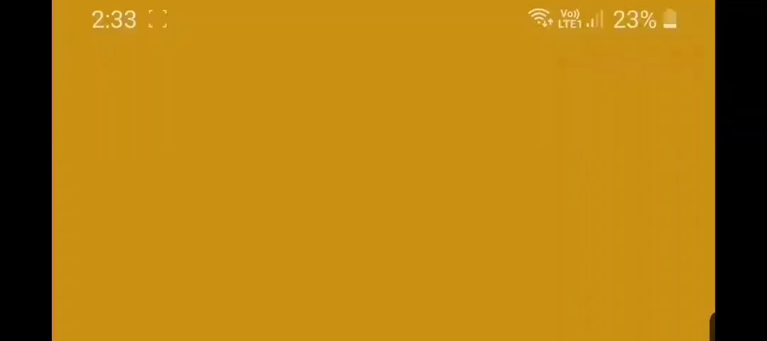
Real time Execution

Slide 11
Future Scope
The application we developed was for android, it can developed for iOS as well.
We can add audio guide to the applications so that the user clearly understands the directions to the destination.
We can develop a plug-in to automatically create a fitting NavMesh from a map that follows certain rules.
We can Make the AR arrow to follow smoothly instead of reappearing.

Slide 12
Any Queries.?

Slide 13
Thank You!

